Slide 1
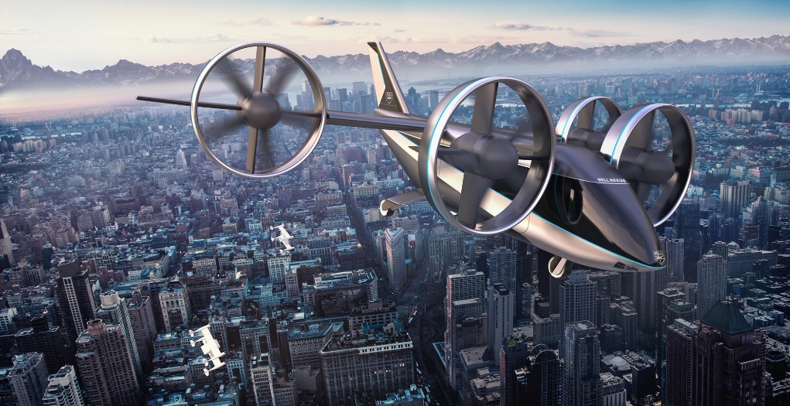
e-VTOL Flying Testbed
Sam Drury
03/12/2020
Supervisor:
Dr Sam Grimshaw
https://www.bellflight.com/products/bell-nexus
Whittle Laboratory

Slide 2
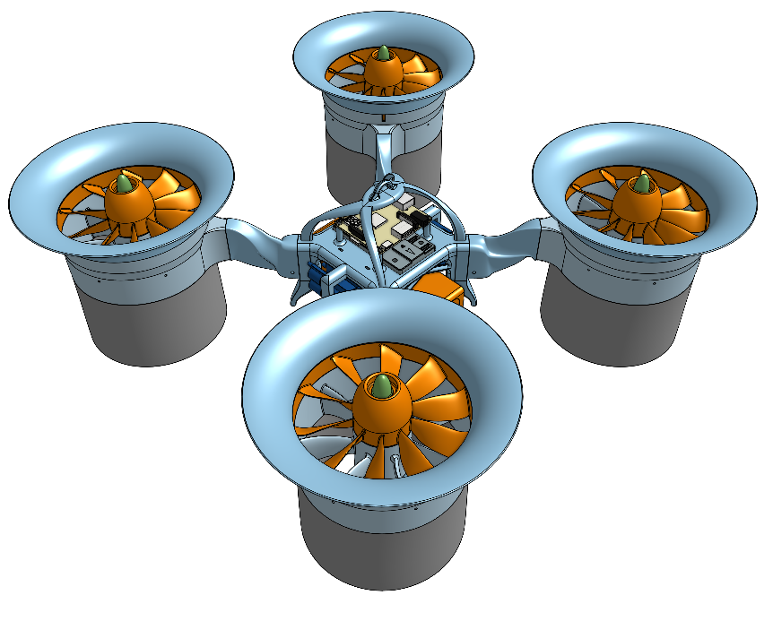
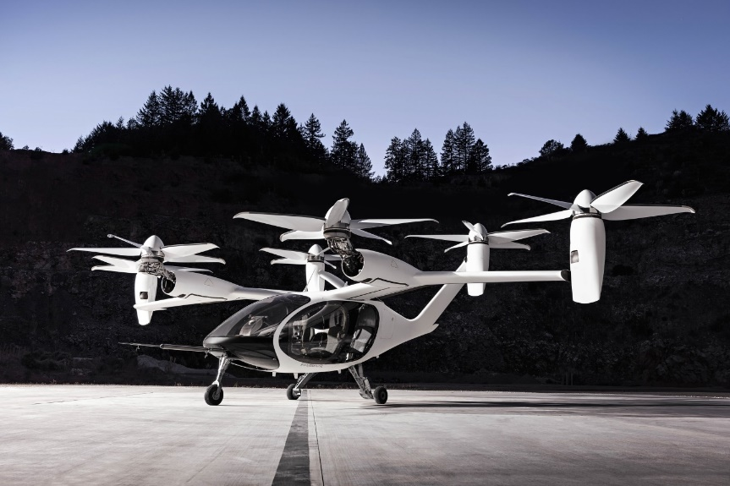
Benefits of Ducted Fans vs Propellors
Ducted Fans can improve hovering performance compared to propellors while being safer and quieter

Slide 3
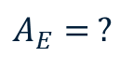

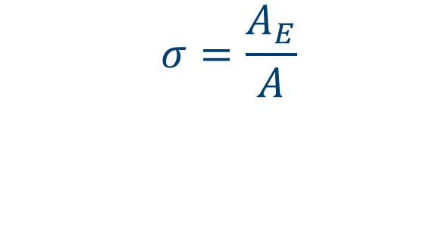
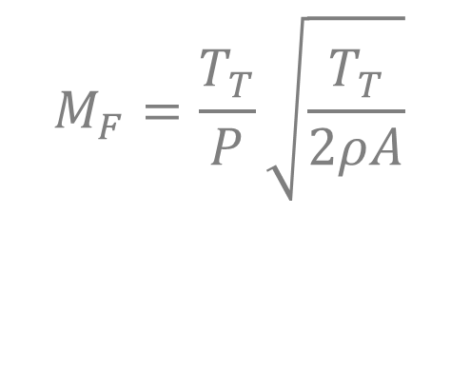



Devising a Suitable Performance Metric
$$M_{F}=\frac{T_{T}}{P}\sqrt{\frac{T_{T}}{2ρA}}$$
$$A$$
$$A_{E}$$
$$M_{F}=\sqrt{2σ}$$
$$A_{E}= ?$$
$$σ=\frac{A_{E}}{A}$$
$$M_{F}=1$$

Slide 4
Project Aims
Ducted Fan design for hover
Characterising Ducted Fan
Develop flying testbed
Stability
In-flight measurements

Slide 5
Design Methods
V1
Assumptions
Isentropic flow
No inlet/exit swirl
1D design
SFME, SFEE
2D design
Radial equilibrium
Mixed vortex
Sweep & lean
Design Process
Axial velocity
Blade speed
Velocities
Flow angles
Chord distribution
Blade angles
Number of blades

Slide 6
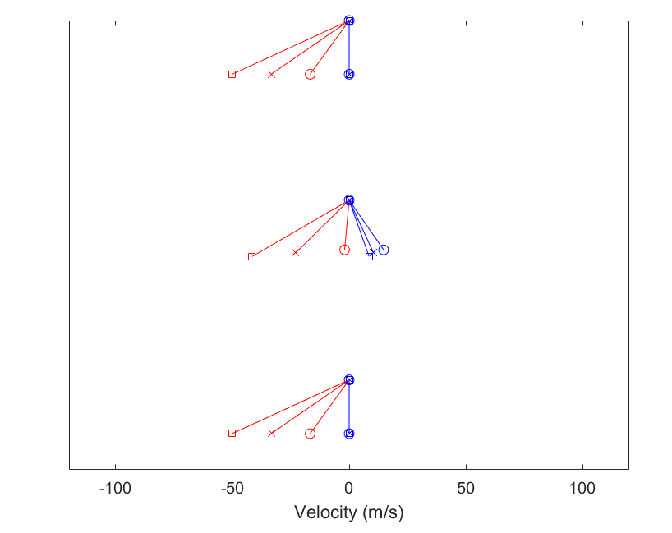
Generating Blade Profiles
V1
Relative Velocities
Absolute Velocities
Vx
(Rotor Plane)
Inputs
Φ, σ, Thrust, Geometry
(Stator Plane)

Slide 7
Design Methods
V2
Assumptions
Isentropic flow
No inlet/exit swirl
1D design
SFME, SFEE
2D design
Radial equilibrium
Mixed vortex
Sweep & lean
Design Process
Inputs
Φ, σ, Thrust, Geometry
Axial velocity
Blade speed
Velocities
Flow angles
Chord distribution
Blade angles
Number of blades

Slide 8
Generating Blade Profiles
V2
Vx
(Rotor Plane)
Relative Velocities
Absolute Velocities
(Stator Plane)

Slide 9
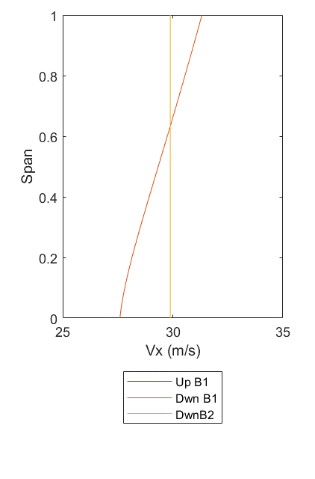
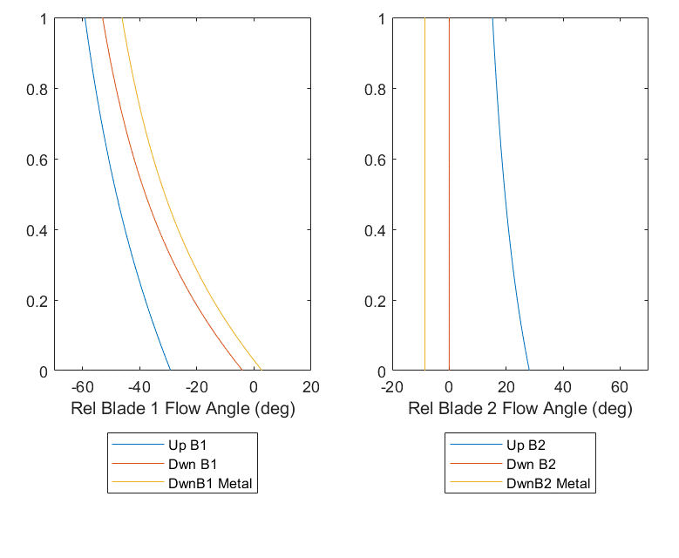
Generating Blade Profiles
Use Lieblein correlation to set midspan chord
Use Carter’s empirical relation to set blade angles

Slide 10
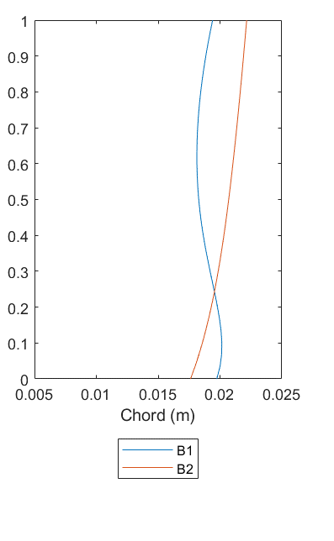
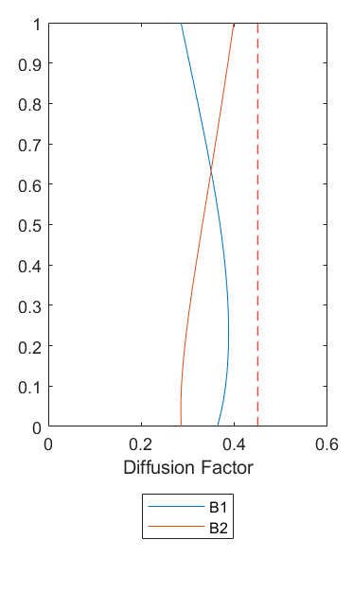
Generating Blade Profiles
Carter’s relation recalculates chord distribution
Lieblein correlation recalculates diffusion factor

Slide 11
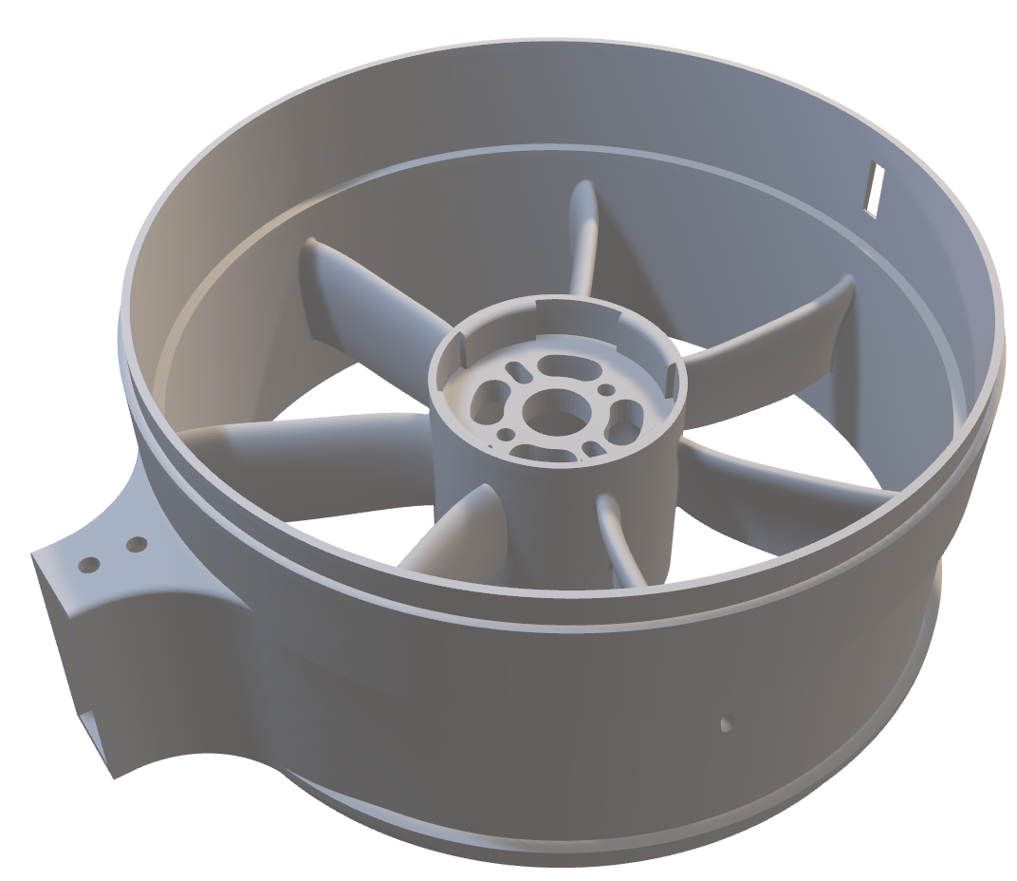
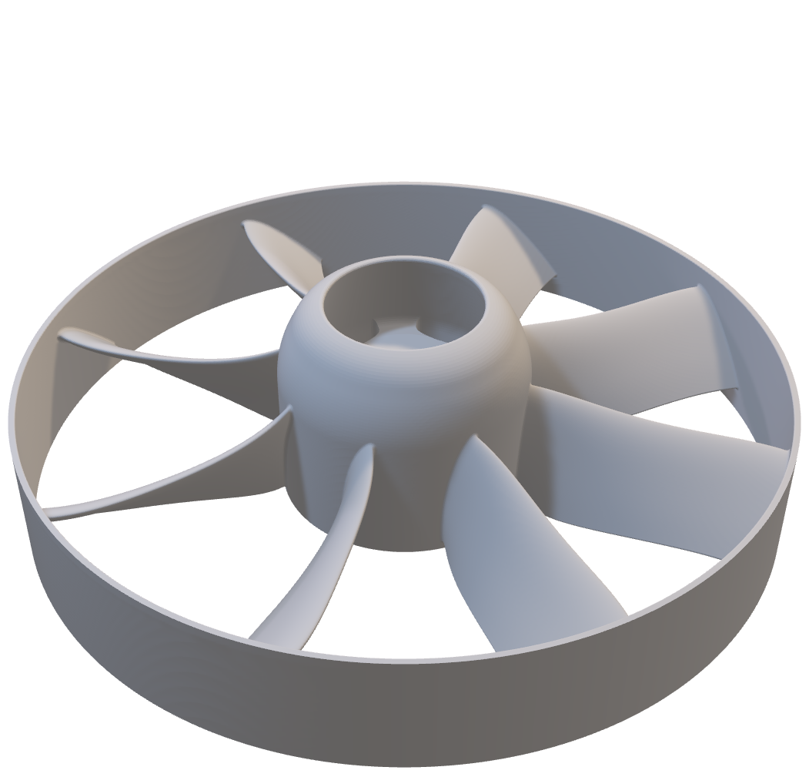
Chosen Design
Sweep & Lean
Adding sweep and lean minimizes end-wall losses

Slide 12
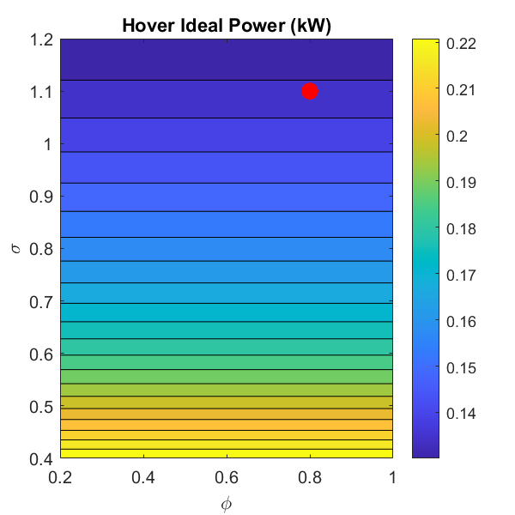
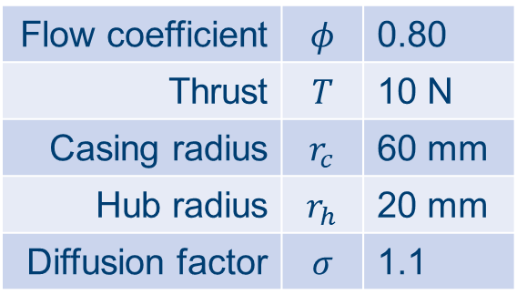
Chosen Design
Flow coefficient | $$φ$$ | 0.80
Thrust | $$T$$ | 10 N
Casing radius | $$r_{c}$$ | 60 mm
Hub radius | $$r_{h}$$ | 20 mm
Diffusion factor | $$σ$$ | 1.1
De Haller number = 0.85 Stall limit = 0.72

Slide 13
Measuring Thrust, RPM, Pressure, Power
Pic of static test rig

Slide 14
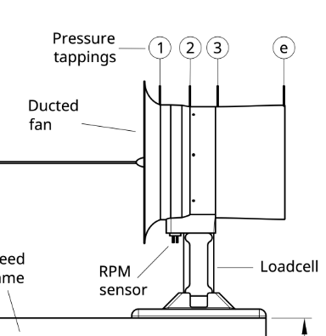
Thrust Measurement
Data Collection
Raspberry Pi
SSH over WiFi
Thrust
Shear Loadcell

Slide 15
RPM Measurement
Data Collection
Raspberry Pi
SSH over WiFi
RPM
RPM Sensor

Slide 16
Pressure Measurement
Data Collection
DSA Pressure Transducer
Ethernet
DSA

Slide 17
Power Measurement
Data Collection
QGroundControl
Telemetry
Power

Slide 18
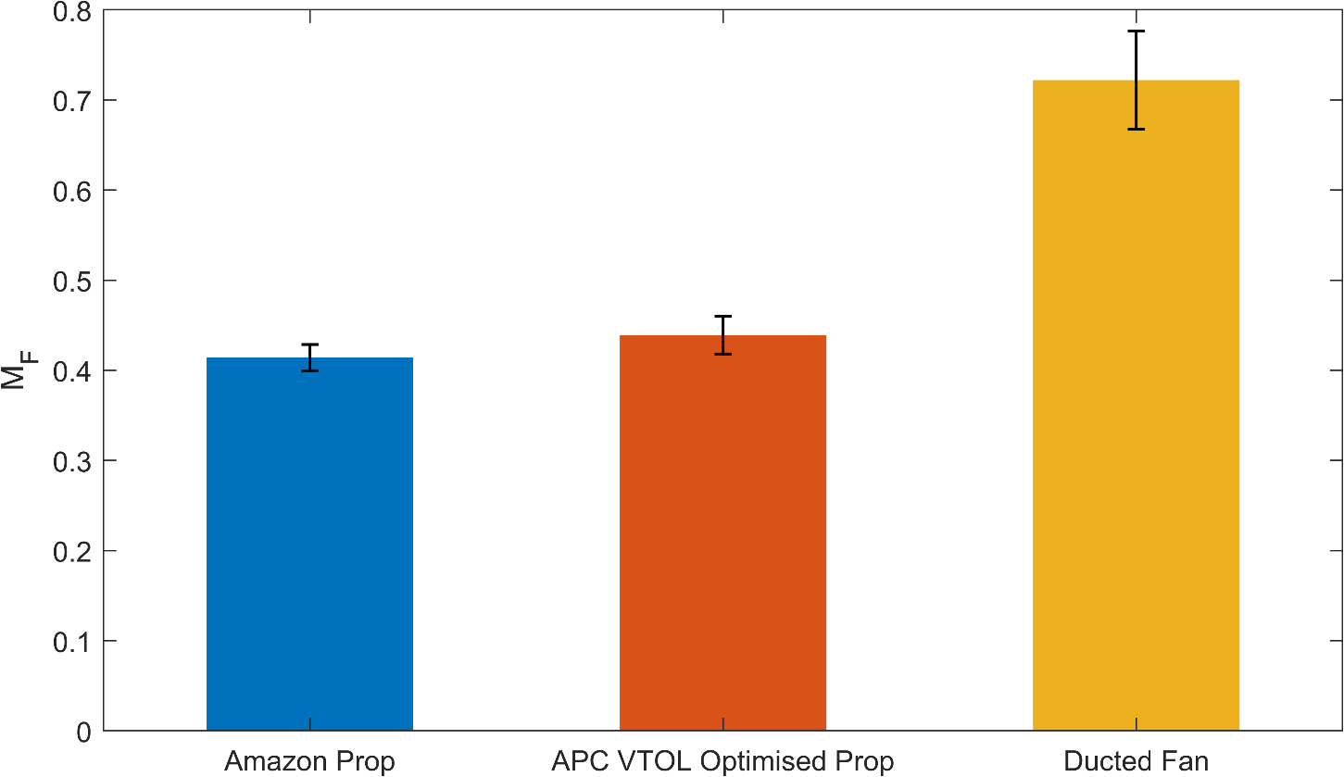
Validating Ducted Fans against Propellors
Ducted fan yields 64% increase in Figure of Merit

Slide 19
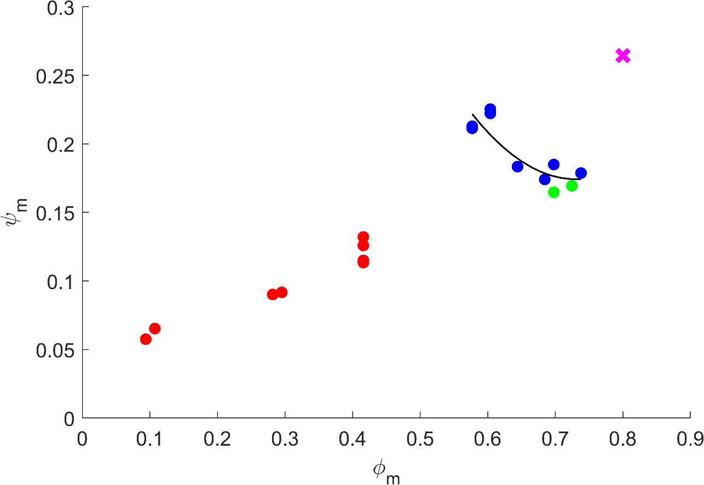
Obtaining Ducted Fan Characteristic by Varying σ
Needs recollecting

Slide 20
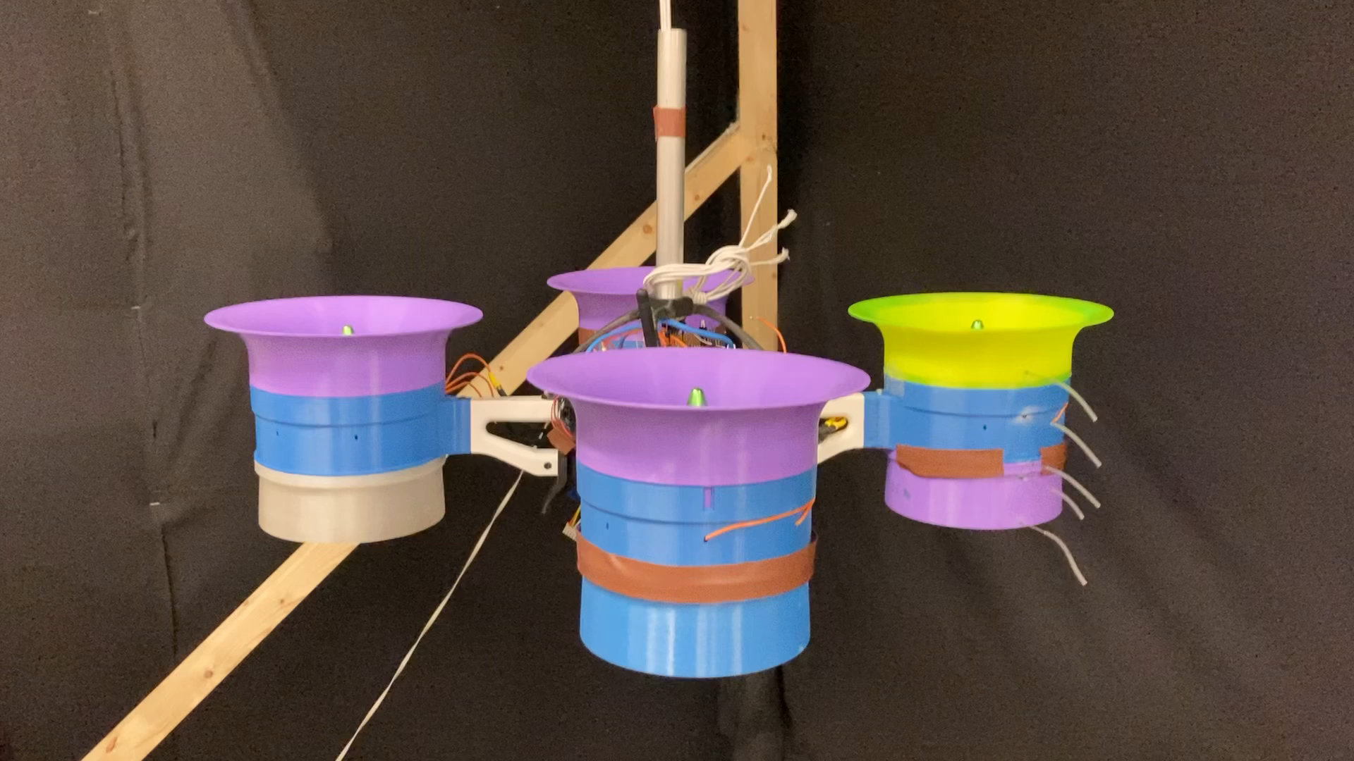
Inaugural Whittle Lab Test Flight!!

Slide 21
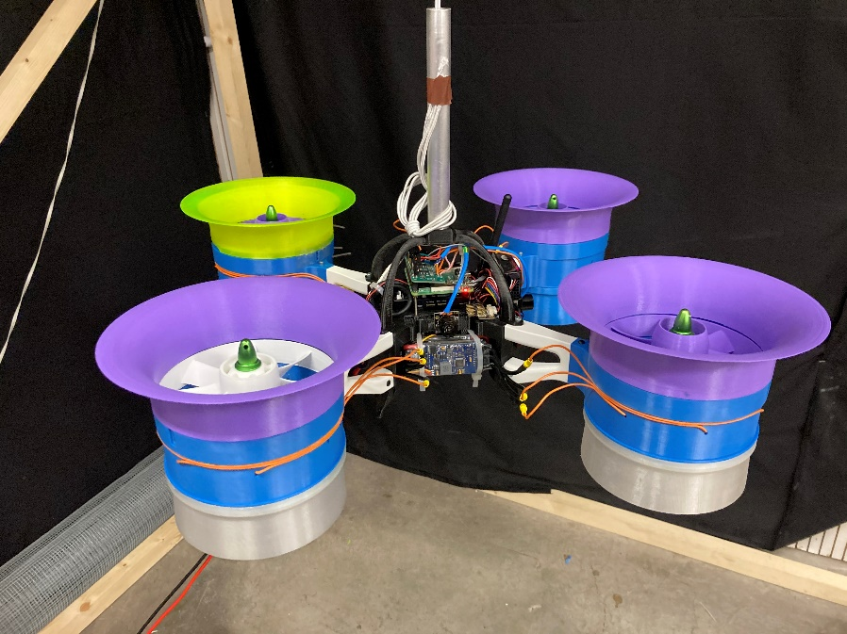
Now we have flying
Capacity to remotely measure:
Power
RPM
Pressures
Stability

Slide 22
Conclusions
So far:
Designed and manufactured 4x EDFs
Proved a 64% increase in FOM for Ducted Fans compared to propellors
Obtained a characteristic for the Ducted Fan
Developed a flying testbed
Going forward:
Ready to improve testbed and use next term
Develop existing EDF design according to work by Jonathan Collins

